Slide 1
Migrating SQL databases to Azure Azure SQL Managed Instance Migration Workshop
Lana Koprivica
Cloud Solution Architect – Data& AI

Slide 2
Agenda
8:30 - 9:00 - Breakfast
9:00 - 9:30 - Adastra introduction
9:30 - 10:15 - SQL MI slides
10:15 - 10:30 - Coffee break
10:30 - 11:30 - Whiteboard session
11:30 - 5:00 - Lab
12:00 - 12:30 Lunch

Slide 3
Agenda
Azure SQL
Migrating to Azure SQL
Scenario – Tailspin Toys Gaming
Hands on Lab

Slide 4
Azure SQL

Slide 5
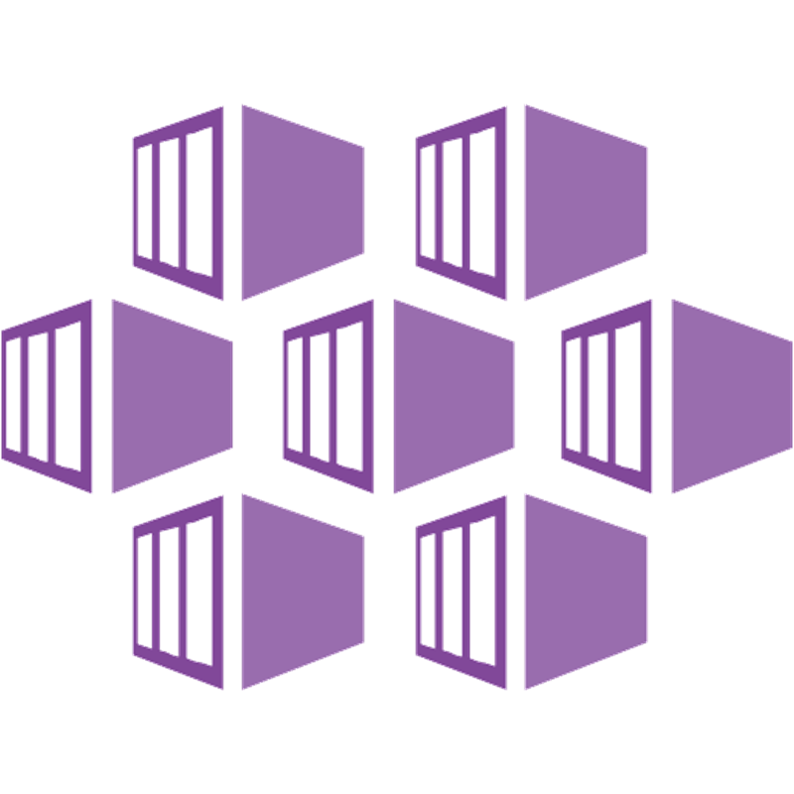


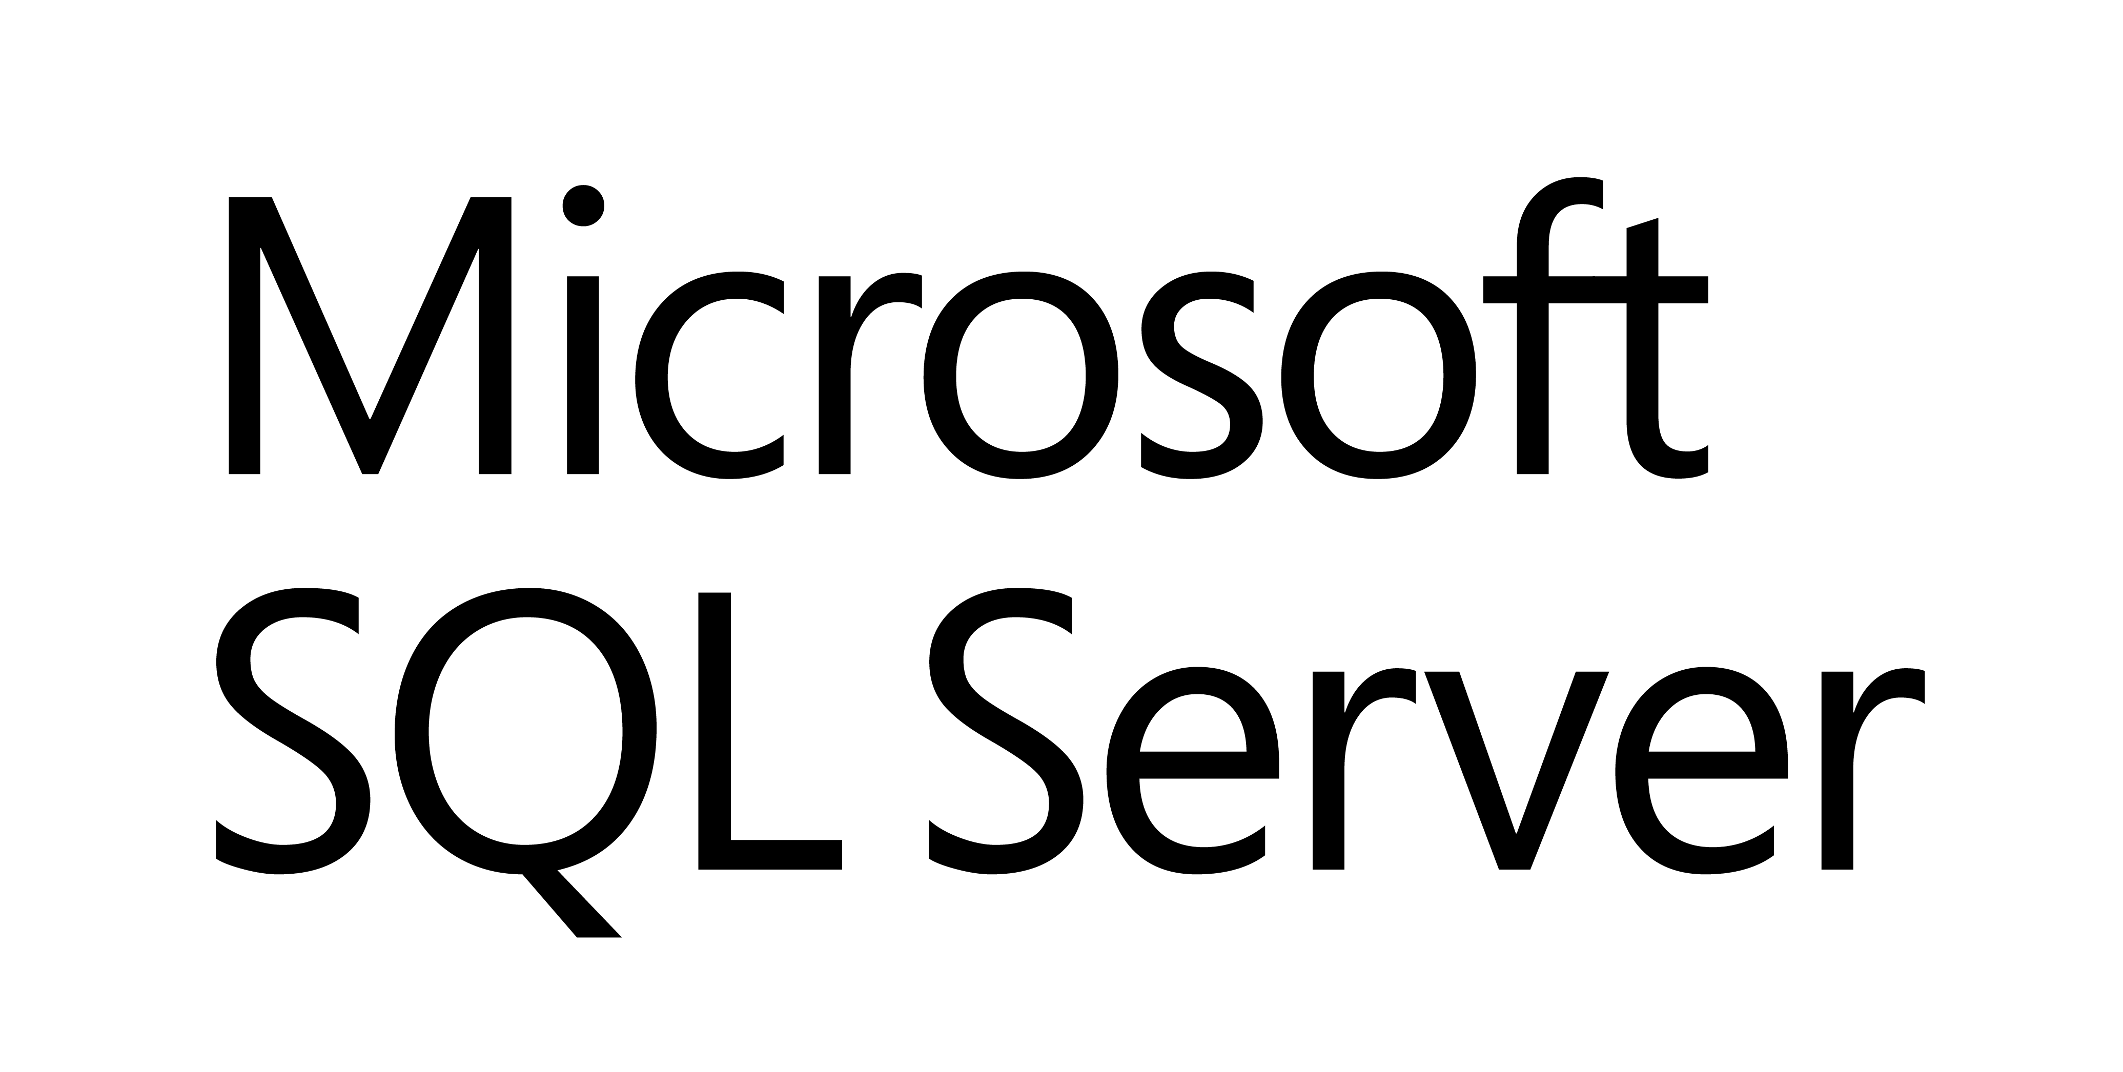

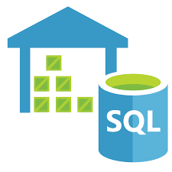
Azure Data Modernization Choices
WWI
SQL Server 2016
SQL Server 2017
SQL Server 2019
SQL
SQL Server in
Azure Virtual Machine (IAAS)
SQL
SQL Server 2008
SQL Server 2008R2
SQL Server 2012
SQL Server 2014
Azure SQL Database
Azure SQL Database Managed Instance
(PAAS)
Azure SQL Data
Warehouse
Notes:
2 mins

Slide 6
Azure SQL Database
The best and most economical cloud destination for your SQL Server
Seamless and compatible
Breakthrough productivity & performance
Industry-leading security
Built-in intelligence
Competitive TCO
The broadest SQL Server compatibility and VNET support
Up to 80% savings with Azure Hybrid Benefit and reserved capacity
Up to 100 TB of on-demand scalable storage per DB
Layers of security and 99.99 percent availability SLA
Intelligent performance tuning and intelligent protection
Notes:
Azure SQL Database is your fully-managed relational database-as-a service:
The best and most economical cloud destination for your SQL Server data
Running on the Microsoft SQL Server engine means it’s high-performing, reliable, and secure
Use it to build data-driven applications/websites in the programming language of your choice, without needing to manage infrastructure
1. Save time and resources by seamlessly migrating SQL Server data to the cloud via a managed instance with a full SQL Server programming surface area that removes the need to re-architect the apps.
2. Realize up to 212% ROI over 3 years by migrating your SQL Server workloads to SQL Database Managed Instance¹ (according to recent Forrester Total Economic Impact study).
Microsoft offers economic incentives, such as the Azure Hybrid Benefit and reserved capacity pricing.
Maximize ROI of migrating to Azure, with savings of up to 80% versus license-included pricing.
Azure SQL Database is the most cost-effective cloud for SQL Server (AWS is 5x more expensive).
3. SQL Database breakthrough productivity and performance meets the demands of today’s apps.
Each database is isolated and portable, each with its own service tier and guaranteed performance level.
Different performance levels for different needs, enabling the pooling of databases to maximize resources and investment.
Adjust performance with minimal downtime to your app and provide foundation for future growth: SQL Database supports very large databases (VLDB) without the headaches, enabling migration and Hyperscale of your databases up to 100TB in constant time.
Dynamic scalability enables your database to transparently respond to rapidly changing resource requirements, and you pay only for the resources you need when you need them.
In-memory technologies enable real-time business insight with up to 30x improved throughput and latency and up to 100x faster queries and reports.
4. Intelligent protection and industry-leading security and privacy capabilities allow you to:
Control access to your databases with multifactor authentication
Leave sensitive data encrypted while in use, with Always Encrypted
Monitor your databases for potential threats and vulnerabilities using Advanced Threat Protection
Protect your data and maintain business continuity with built-in high availability and business continuity tools.
Azure's financially-backed 99.99% availability SLA², powered by a global network of Microsoft-managed datacenters over 38 regions, helps keep your apps running 24/7.
Minimize data loss from disruptive events achieve recovery with recovery point objective (RPO) of less than 5 seconds. (AWS provides an RPO commitment of 5 minutes)
Protect against data center outages with up to four readable secondary databases enabled through active geo-replication.
Automatically create full, differential, and transaction log backups every 5 - 10 minutes.
Restore an existing database to an earlier point in time up to 35 days on the same logical server.
5. SQL Database also has built-in intelligence that helps customers dramatically reduce the costs of running and managing databases and maximizes both the performance and security of their application.
Source:
¹The Total Economic ImpactTM of Microsoft Azure SQL Database Managed Instance, Forrester Consulting, September 2018
² We guarantee at least 99.99% of the time customers will have connectivity between their single or elastic Basic, Standard, or Premium Microsoft Azure SQL Database and our Internet gateway. See “SLA for SQL Database” for more information (https://azure.microsoft.com/en-us/support/legal/sla/sql-database/v1_1/)

Slide 7

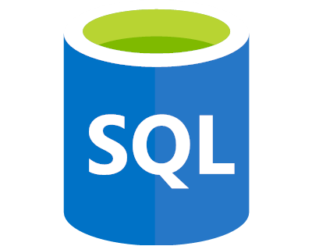
Azure SQL
SQL virtual machines
Managed instances
Databases
Best for migrations and applications requiring OS-level access
Best for most lift-and-shift migrations to the cloud
Best for modern cloud applications. Hyperscale and serverless options are available
SQL virtual machine
Single instance
Single database
Elastic pool
SQL Server and OS server access
Expansive SQL and OS version support
Automated manageability features for SQL Server
SQL Server surface area (vast majority)
Native virtual network support
Fully managed service
Hyperscale storage (up to 100TB)
Serverless compute
Fully managed service
Resource sharing between multiple databases to price optimize
Simplified performance management for multiple databases
Fully managed service

Slide 8
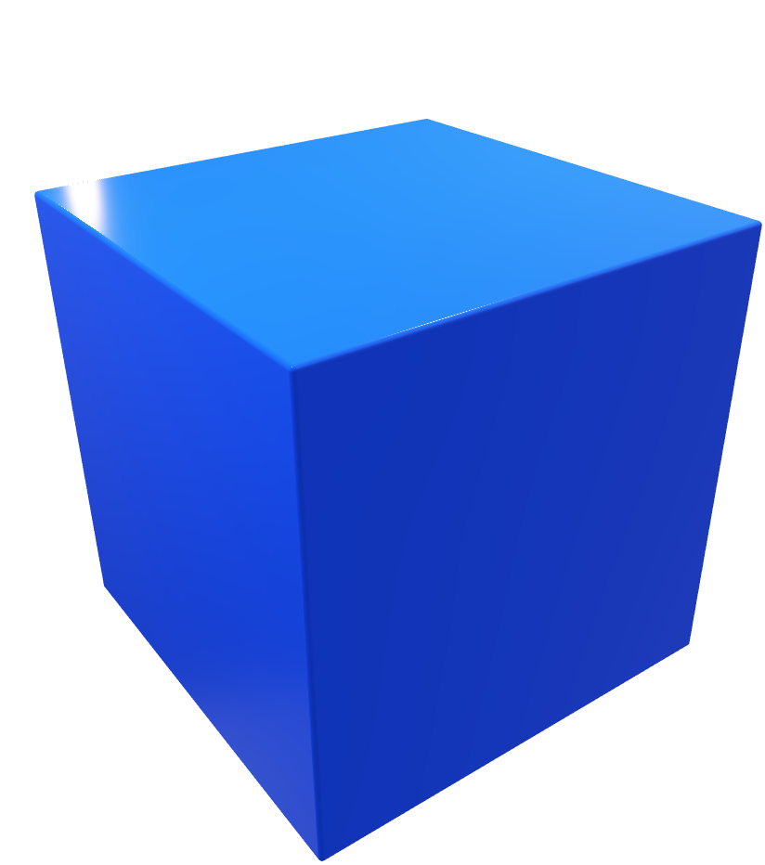

Azure SQL: multi-faceted service
Compute tier
Provisioned, Serverless
Tier General Purpose, Hyperscale, Business Critical
Deployment VM, Managed Instance, Single Database, Elastic Pools
Not all combinations are possible.

Slide 9



Azure SQL: multi-faceted service
Provisioned | General Purpose | Hyperscale | Business Critical
VM | NA | NA | NA
Managed Instance
Single Database
Elastic Pool
Serverless | General Purpose | Hyperscale | Business Critical
VM | NA | NA | NA
Managed Instance
Single Database
Elastic Pool

Slide 10
Azure SQL Database — Everything built-in
Business continuity
High availability
Automated backups
Long term backup retention
Geo-replication
Scale
Advanced security
Automatic tuning
Built-in monitoring
Built-in intelligence
Notes:
Business continuity enables your business to continue operating in the face of disruption, particularly to its computing infrastructure.
High availability of Azure SQL Database guarantees your databases are up and running 99.99% of the time, no need to worry about maintenance/downtimes.
2 read replicas - GP
3 replicas, 1 read-scale replica, zone-redundant HA - BC
Primary read/write replica + up to 4 read replicas - HS
Automated backups are created and use Azure read-access geo-redundant storage (RA-GRS) to provide geo-redundancy.
Also Point in Time restore
Long term backup retention enables you to store specific full databases for up to 10 years.
Geo-replication by creating readable replicas of your database in the same or different data center (region). You can manually failover to readable replicas
Also Auto-failover groups allows an application to recover in case of a data center outage
Scale by easily adding more resources (CPU, memory, storage) without long provisioning.
Advanced security detects threats and vulnerabilities in your databases and enables you to secure your data.
Automatic tuning analyzes your workload and provides you the recommendations that can optimize performance of your applications by adding indexes, removing unused indexes, and automatically fixing the query plan issues.
Built-in monitoring capabilities enable you to get the insights into performance of your databases and workload, and troubleshoot the performance issues.
Built-in intelligence automatically identifies the potential issues in your workload and provides you the recommendations that can help you to fix the problems.

Slide 11

Azure SQL Database — Everything built in
VMs
configurable
Business continuity
High availability
Automated backups
Long term backup retention
Geo-replication
Scale
Advanced security
Automatic tuning
Built-in monitoring
Built-in intelligence
Notes:
Configurable could be replaced with “choice of automation”
SQL VM with defaults; “automated security patching” comes as built-in.
But, can use services (automations provided by Microsoft for free) to enable:
-HA for an SLA they choose, either 99.95% or 99.99%
-Automated backup
-Advanced threat detection and vulnerability assessment
They can do the followings manually, but we do not have an automation for that:
-Add readable DR replica in same region; different zone
-Add a Geo-Dr replica
With VM deployment type they can “Control” the level of Managebility they prefer.
E.g., do not have to sacrifice their patching or update policies to get automated HADR.
Can choose form available administration services and configure only the ones they prefer.
Flexible platform where you can add-on the services they want and keep manual maintenance on others.

Slide 12



The Allscripts prescription for agility: lift and shift to the cloud
Allscripts is a leading healthcare software manufacturer, serving physician practices, hospitals, health plans, and Big Pharma. To transform its applications frequently and host them securely and reliably, Allscripts has started to use Microsoft Azure. In just three weeks, the company lifted and shifted dozens of acquired applications running on 1,000 virtual machines to Azure with Azure Site Recovery. Allscripts also develops software in Azure and realizes dramatic time-to-market gains and savings by using the Azure platform as a service offering.
Microsoft Azure
Azure Site Recovery
Azure SQL Database
Azure Virtual Machines
Azure Cosmos DB
10,000 employees
Partner professional services
United States
Notes:
https://customers.microsoft.com/en-us/story/allscripts-partner-professional-services-azure

Slide 13
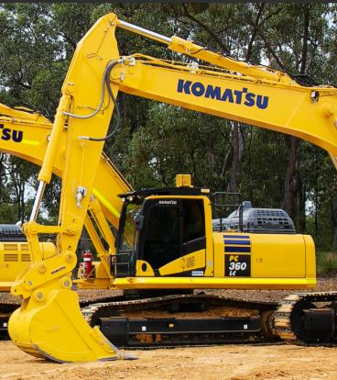
Komatsu achieves breakthrough performance gains and savings with Azure SQL Database Managed Instance
Challenge
Had multiple mainframe applications for different types of data, and needed to consolidate them into a single system so that different parts of the organization can easily get a holistic view of data from different sources
Impact
Moved the entire database and the Discovery Hub analytics implementation to Azure SQL Database Managed Instance in less than two weeks, and since then we’ve seen a 49 percent cost reduction and 25 to 30 percent performance gains.
“We determined Azure SQL Database Managed Instance was the best choice for us in terms of scalability, cost, and performance.… We’ve seen a 49 percent cost reduction and 25 to 30 percent performance gains..”
Nipun Sharma: Analytics Architect, Business Technology and Systems
Komatsu Australia
Notes:
https://customers.microsoft.com/en-us/story/komatsu-australia-manufacturing-azure

Slide 14


AccuWeather weathers the storm with Azure
The company first moved its API business to Azure. AccuWeather sells a host of weather-related APIs that news outlets and other companies plug into their enterprise resource planning, customer relationship management, and other business applications. The company receives more than 40 billion API calls a day for weather information, and Azure provides a more scalable, cost-effective way to manage this service.
Next the company moved its big data storage and processing, using services such as Azure Blob storage, Azure Data Factory, and Azure SQL Database.
When AccuWeather set out to build an automated, scalable weather prediction service for business customers, it turned to Azure as well. To create highly accurate forecasts, Radich’s team needed sophisticated machine learning tools that it could customize using R and Python code.
“With Azure, we have access to sophisticated data science services in a real-time, on-demand basis, which helps us innovate faster.”
- Chris Patti: Chief Technology Officer, AccuWeather
Azure API Management
Azure App Service
Azure Data Factory
Azure Machine Learning
Azure SQL Database
Azure Storage
Medium (50 - 999 employees)
Professional Services
USA
Notes:
https://customers.microsoft.com/en-us/story/accuweather-partner-professional-services-azure

Slide 15


World-class, cloud-enabled time and labor application.
Challenge
Flex Time by Paychex handles 13 million timecards and 3 million distinct punches on any given day for over 650,000 customers. With an increasing volume of customers, however, managing that environment became very cumbersome. Guaranteeing uptime meant constant investments in new hardware, which was both time-consuming and capital-intensive.
Impact
Paychex engineers are freed from managing infrastructure, licensing, and database spin up and spin down. Built-in intelligent features like automatic tuning optimize database performance, leaving them to focus on what they do best: understand how clients are accessing the app and provide value in their continuous delivery pipeline.
“Azure SQL Database allows us to execute upgrades and releases without our customers ever knowing it, which is critical for an application that runs 24/7/365.”
Dave Wilson: Sr. Director of IT Infrastructure and Architecture
Notes:
https://customers.microsoft.com/en-us/story/paychex-azure-sql-database-us

Slide 16
General Purpose
Feature | Description
Number of vCores* | 8, 16, 24 (Gen 4) 8, 16, 24, 32, 40, 64, 80 (Gen 5)
SQL Server version / build | SQL Server (latest available)
Min storage size | 32 GB
Max storage size | 8 TB
Max storage per database | Determined by the max storage size per instance
Expected storage IOPS | 500-7500 IOPS per data file (depends on data file). See Premium Storage
Number of data files (ROWS) per the database | Multiple
Number of log files (LOG) per database | 1
Managed automated backups | Yes
HA | Based on remote storage and Azure Service Fabric
Built-in instance and database monitoring and metrics | Yes
Automatic software patching | Yes
VNet - Azure Resource Manager deployment | Yes
VNet - Classic deployment model | No
Portal support | Yes
Redundant nodes
Azure storage accounts
Active compute nodes

Slide 17
Business Critical
Primary endpoint
(read-write)
Read-only endpoint
Feature | Description
Number of vCores* | 8, 16, 24, 32 (Gen 4) 8, 16, 24, 32, 40, 64, 80 (Gen 5)
SQL Server version / build | SQL Server (latest available)
Additional features | In-Memory OLTP 1 additional read-only replica (Read Scale-Out)
Min storage size | 32 GB
Max storage size | Gen 4: 1 TB (all vCore sizes Gen 5:1 TB for 8, 16 vCores 2 TB for 24 vCores 4 TB for 32, 40, 64, 80 vCores
Max storage per database | Determined by the max storage size per instance
Number of data files (ROWS) per the database | Multiple
Number of log files (LOG) per database | 1
Managed automated backups | Yes
HA | Based on Always On Availability Groups and Azure Service Fabric
Built-in instance and database monitoring and metrics | Yes
Automatic software patching | Yes
VNet - Azure Resource Manager deployment | Yes
VNet - Classic deployment model | No
Portal support | Yes
Always On AG
SQL
Super-fast SSD
SQL
Primary replica
Secondary replica
SQL
SQL
Secondary replica
Secondary replica
Business Critical service tier: collocated compute and storage

Slide 18
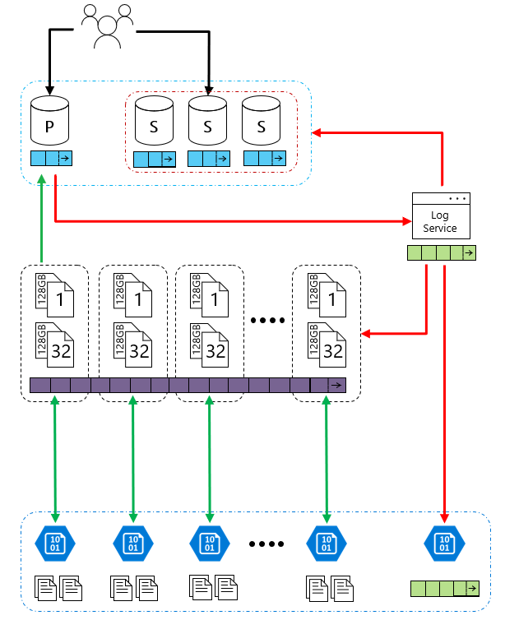
Hyperscale
Feature | Description
Number of vCores* | Gen4: 1 to 24 vCore Gen5: 2 to 80 vCore
SQL Server version / build | SQL Server (latest available)
Additional features | 4 read-scale replicas 100TB Data Support Constant Time Operations
Min storage size | 4 GB
Max storage size | 100TB Grows as customer data grows
Max storage per database | Determined by the max storage size per instance
Number of data files (ROWS) per the database | Multiple
Number of log files (LOG) per database | 1
Managed automated backups | Yes
HA | High Availability is ensured on the storage layer
Built-in instance and database monitoring and metrics | Yes
Automatic software patching | Yes
VNet - Azure Resource Manager deployment | Yes
VNet - Classic deployment model | No
Portal support | Yes
Hyperscale Service Tier – Availability of Storage

Slide 19

What is Azure SQL Database Hyperscale?
SQL
Storage
Cloud native
Seamless compatibility
Scalable new storage architecture
Architected for cloud
Fully compatible with Azure SQL Database
Performance
No limits
Large database
VLDB operations without VLDB headaches
Scale compute and storage
Support for 100TB+
Notes:
Hyperscale is an all new storage layer under the database
Hyperscale is architected for the cloud from the ground up.
Hyperscale is fully compatible with Azure SQL Database
Hyperscale is no limits
Hyperscale is VLDB size without the VLDB headaches
Support for 100TB+

Slide 20
Read IO – service tiers comparison
HS
BC
Proportional to compute size
RBPEX
Files
Page Servers
<0.5ms for all data access
RBPEX
Full coverage
Azure Storage
Azure Storage
~2ms for all data access
Attached SSD
<0.5ms for hot data access
~2ms otherwise
Remote Storage
General purpose
Hyperscale
Business critical

Slide 21
Flexible compute, storage & performance options
Simplicity
We remain committed to the DTU-based model and the simplicity it offers customers who want a pre-configured solution
Flexibility:
The vCore-based model reflects our commitment to customer choice and to simplify the hybrid benefit for customers migrating from on-premises
Customers pay for:
Service tier + number of vCores
Type and amount of data storage
Number of IO
Backup storage (RA-GRS)
Service tier | General purpose |  | Business critical |  | Hyperscale
Best for | Most budget-oriented workloads |  | Critical business applications with high IO requirements. |  | VLDB OLTP and HTAP workloads with highly scalable storage and read-scale requirements
Deployment option | Single / Elastic Pools | Managed Instance | Single / Elastic Pools | Managed Instance | Single
Compute tiers | Gen4: 1 to 24 vCore Gen5: 2 to 80 vCore Serverless: 0.5 to 16 vCore (preview) | Gen4: 4 to 24 vCore Gen5: 4 to 80 vCore | Gen4: 1 to 24 vCore Gen5: 2 to 80 vCore | Gen4: 4 to 24 vCore Gen5: 4 to 80 vCore | Gen4: 1 to 24 vCore Gen5: 2 to 80 vCore
Storage | Premium remote |  | Local SSD |  | Local SSD Cache
 | 32GB – 8TB per instance | 32GB – 8TB per instance | 32GB – 4TB per instance | 32GB – 8TB per instance | Scale from 5GB to 100TB of storage in 1GB increments
In-Memory | Not supported |  | Supported |  | Not supported
Read-write IO | ~2ms for all data access |  | <0.5ms for all data access |  | <0.5ms for hot data access ~2ms otherwise
Availability | 2 read replicas |  | 3 read replicas, zone-redundant HA | 3 replicas, 1 read-scale replica, zone-redundant HA | Primary read/write replica + up to 4 read replicas
Backups | RA-GRS, 7-35 days (7 days by default) |  | RA-GRS, 7-35 days (7 days by default) |  | LRS, ZRS, RA-GRS, 7-35 days (7 days by default)
For latest information reference: https://azure.microsoft.com/en-us/pricing/details/sql-database/
Notes:
https://azure.microsoft.com/en-us/pricing/details/sql-database/
vCore model so we can get AHB: 1 Enterprise license core = 1 Business Critical core
Business critical because online gaming wants the highest performance and HA
Gen 5 so we can scale our compute more
Also for read-scale replica, zone redundant HA
Zone-redundant storage (ZRS) replicates your data synchronously across three storage clusters in a single region. Each storage cluster is physically separated from the others and is located in its own availability zone (AZ). Each availability zone—and the ZRS cluster within it—is autonomous and includes separate utilities and networking features. A write request to a ZRS storage account returns successfully only after the data is written to all replicas across the three clusters.
When you store your data in a storage account using ZRS replication, you can continue to access and manage your data if an availability zone becomes unavailable. ZRS provides excellent performance and low latency. ZRS offers the same scalability targets as locally redundant storage (LRS).

Slide 22
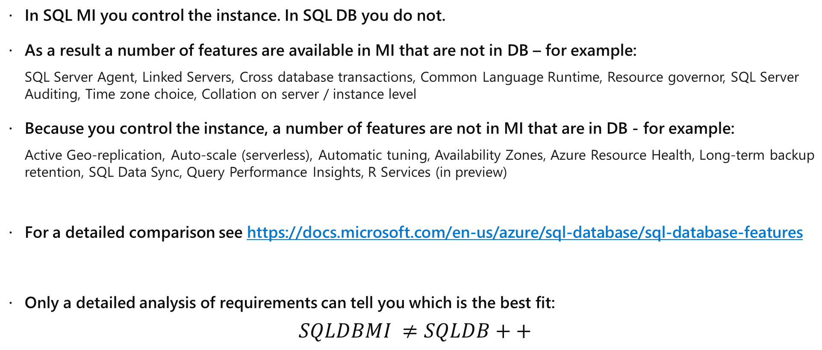
SQL Database versus Managed Instance
Instance
In SQL MI you control the instance. In SQL DB you do not.
As a result a number of features are available in MI that are not in DB – for example:
SQL Server Agent, Linked Servers, Cross database transactions, Common Language Runtime, Resource governor, SQL Server Auditing, Time zone choice, Collation on server / instance level
Because you control the instance, a number of features are not in MI that are in DB - for example:
Active Geo-replication, Auto-scale (serverless), Automatic tuning, Availability Zones, Azure Resource Health, Long-term backup retention, SQL Data Sync, Query Performance Insights, R Services (in preview)
For a detailed comparison see https://docs.microsoft.com/en-us/azure/sql-database/sql-database-features
Only a detailed analysis of requirements can tell you which is the best fit:
$$SQLDBMI ≠SQLDB++$$

Slide 23

Hyperscale and Azure DW
HS
SMP
Hyperscale
Real-time analytics/HTAP
SQL Server, Oracle…
MPP
Azure DW
Big Data Analysis
APS, Teradata…

Slide 24
Migrating to Azure SQL

Slide 25
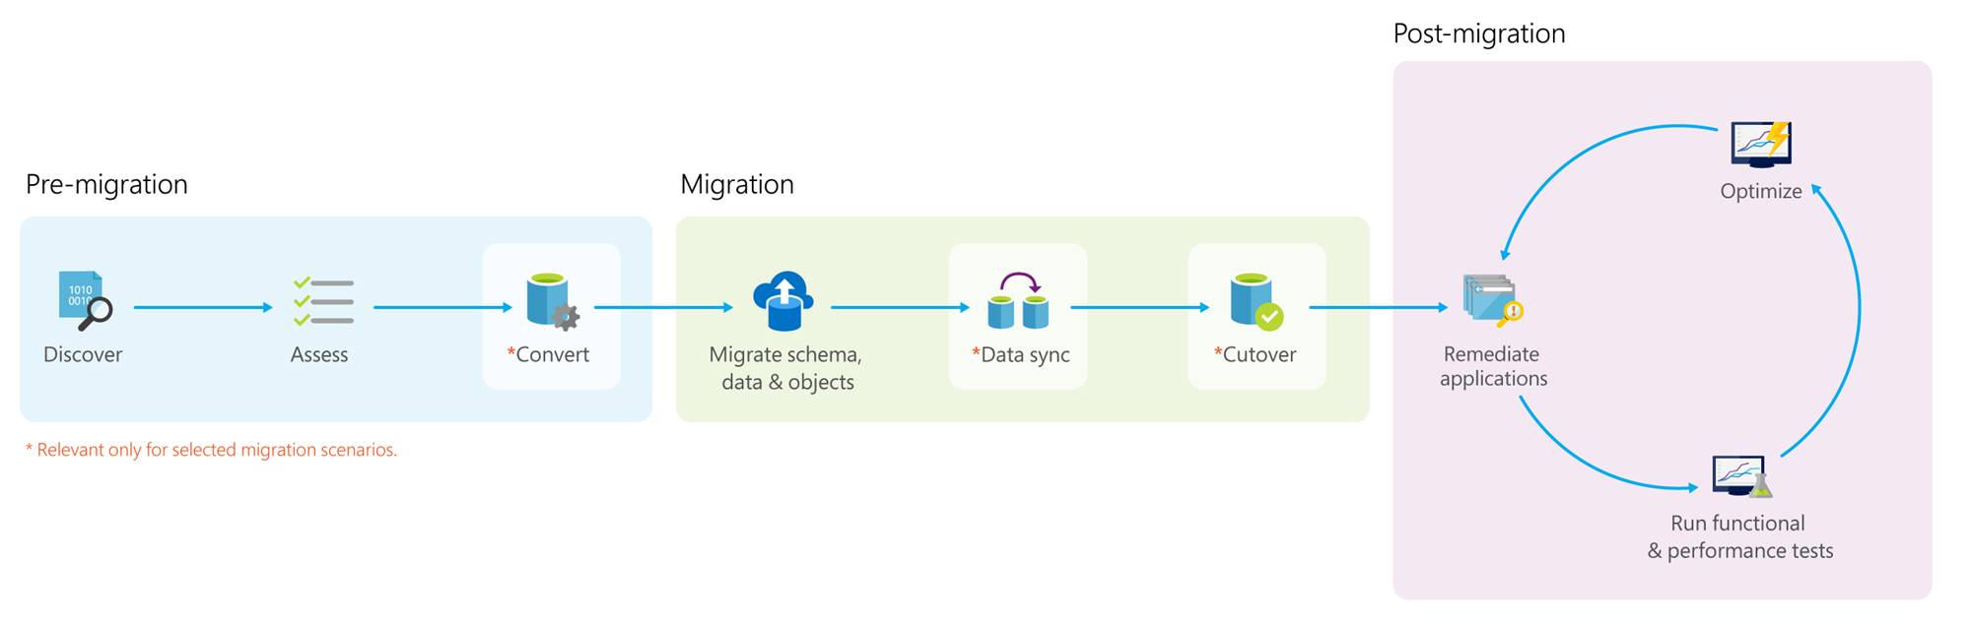
Data Migration Process
Notes:
*Pre-migration*:
- **Discover**: Inventory your source database assets and perform an application stack discovery.
- **Assess**: Assess source workloads and fix recommendations.
- **Convert**: Convert the source schema to work in the target environment. This is only relevant for heterogeneous migrations.
*Migration*:
- **Migrate schema, data, and objects**: Migrate the source schema and then migrate the source data to the target.
- **Sync data**: Sync your target schema and data with the source. This is only relevant for minimal-downtime migrations.
- **Cutover**: Cut over from the source to the target environment. This is only relevant for minimal-downtime migrations.
*Post-migration*:
- **Remediate applications**: Iteratively make any necessary changes to your applications.
- **Perform Tests**: Iteratively run functional and performance tests.
- **Optimize**: Based on the tests you performed, address any performance issues and then retest to confirm the performance improvements.

Slide 26
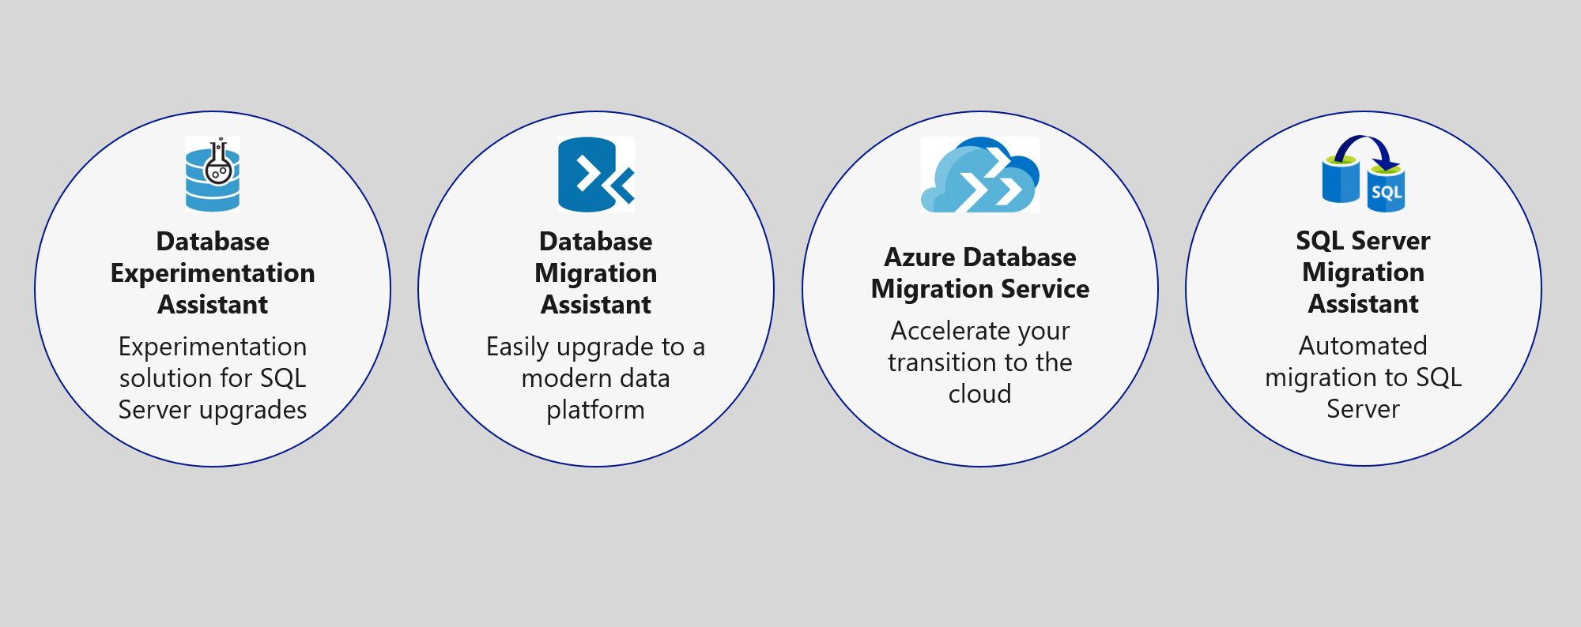
Upgrade & migration tools
NEW
Azure Migrate + DMS + DMA
Notes:
The Azure SQL data platform consists of three options:
SQL Server on an Azure VM
Azure SQL Database Managed Instance
Azure SQL Database
Each of the options will be discussed in more detail in the slides that follow.

Slide 27
Azure Migration Program (AMP)
Available to all Azure customers, scaled through specialized migration partners
Best practice guidance
Offers and incentives
Technical skill building
Infrastructure and data foundations
Migration planning and execution
Digital resources
Migration
Tools
Azure trainers
FastTrack for Azure engineers
Specialized partners
Reduce cost and risk | Accelerate migration velocity | Deliver customer success
Learn more | Azure.com/AMP
Notes:
The Azure Migration Program gives you prescriptive guidance for a step by step approach to cloud migration. AMP offers the opportunity to work closely with Microsoft experts and specialized migration partners to simplify and accelerate your migration.
The program delivers:
Technical skill building to ensure your organization can successfully adopt Azure
Best practices for a step by step approach from start to finish
Azure engineering support for data and infrastructure foundations
Expert guidance from specialized migration partners
Free Azure tools to help you efficiently execute migrations
And cost effective offers to help you save money before, during, and after migration

Slide 28
Lab Scenario

Slide 29
Modernizing the WideWorldImporters Gaming Division
Tailspin Toys Gaming (online gameplay) was acquired by WideWorldImporters
Primarily SQL Server 2008 R2
Founded in 2010, exponential growth since then
Gaming services (VMs/databases) run on rented hardware
Primarily software developers, few infrastructure and database resources
Desire to build more intelligent applications with AI and Machine Learning
What, when, and how can I migrate to the cloud?
Want to leverage new security and performance features in Azure they’ve heard about
Need Service Broker, do not want to rearchitect the solution to use an alternative
Applications need better availability and less downtime

Slide 30

Customer concerns
Looking for comparison of SQL database hosting options in Azure.
What tools can help a evaluate databases against target platforms and identify potential issues?
Can we have network isolation and secure channel access from on-premises?

Slide 31
Pre-migration

Slide 32
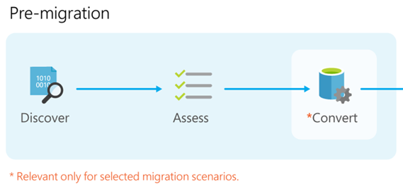
Data Migration Process
Notes:
*Pre-migration*:
- **Discover**: Inventory your source database assets and perform an application stack discovery.
- **Assess**: Assess source workloads and fix recommendations.
- **Convert**: Convert the source schema to work in the target environment. This is only relevant for heterogeneous migrations.
*Migration*:
- **Migrate schema, data, and objects**: Migrate the source schema and then migrate the source data to the target.
- **Sync data**: Sync your target schema and data with the source. This is only relevant for minimal-downtime migrations.
- **Cutover**: Cut over from the source to the target environment. This is only relevant for minimal-downtime migrations.
*Post-migration*:
- **Remediate applications**: Iteratively make any necessary changes to your applications.
- **Perform Tests**: Iteratively run functional and performance tests.
- **Optimize**: Based on the tests you performed, address any performance issues and then retest to confirm the performance improvements.

Slide 33

Tailspin Toys – Recommended database
Azure SQL Database Managed Instance
Platform-as-a-Service (PaaS)
Supports database migration from on-premises with minimal to no database changes (i.e. Service Broker)
Provides the benefits of Azure SQL Database but adds capabilities that were previously only available in SQL VMs
Includes a native virtual network (VNet) and near 100% compatibility with on-premises SQL Server
Notes:
Managed instance is a new deployment option of Azure SQL Database, providing near 100% compatibility with the latest SQL Server on-premises (Enterprise Edition) Database Engine.
Provides a native virtual network (VNet) implementation that addresses common security concerns, and a business model favorable for on-premises SQL Server customers.
The managed instance deployment model allows existing SQL Server customers to lift and shift their on-premises applications to the cloud with minimal application and database changes.
At the same time, the managed instance deployment option preserves all PaaS capabilities (automatic patching and version updates, automated backups, high-availability ), that drastically reduces management overhead and TCO.
Adds features that are not available in Azure SQL Database, such as cross-database queries, linked servers, CLR modules, and Service Broker.

Slide 34
Flexible compute, storage & performance options
Simplicity
We remain committed to the DTU-based model and the simplicity it offers customers who want a pre-configured solution
Flexibility:
The vCore-based model reflects our commitment to customer choice and to simplify the hybrid benefit for customers migrating from on-premises
Customers pay for:
Service tier + number of vCores
Type and amount of data storage
Number of IO
Backup storage (RA-GRS)
Service tier | General purpose |  | Business critical |  | Hyperscale
Best for | Most budget-oriented workloads |  | Critical business applications with high IO requirements. |  | VLDB OLTP and HTAP workloads with highly scalable storage and read-scale requirements
Deployment option | Single / Elastic Pools | Managed Instance | Single / Elastic Pools | Managed Instance | Single
Compute tiers | Gen4: 1 to 24 vCore Gen5: 2 to 80 vCore Serverless: 0.5 to 16 vCore (preview) | Gen4: 4 to 24 vCore Gen5: 4 to 80 vCore | Gen4: 1 to 24 vCore Gen5: 2 to 80 vCore | Gen4: 4 to 24 vCore Gen5: 4 to 80 vCore | Gen4: 1 to 24 vCore Gen5: 2 to 80 vCore
Storage | Premium remote |  | Local SSD |  | Local SSD Cache
 | 32GB – 8TB per instance | 32GB – 8TB per instance | 32GB – 4TB per instance | 32GB – 8TB per instance | Scale from 5GB to 100TB of storage in 1GB increments
In-Memory | Not supported |  | Supported |  | Not supported
Read-write IO | ~2ms for all data access |  | <0.5ms for all data access |  | <0.5ms for hot data access ~2ms otherwise
Availability | 2 read replicas |  | 3 read replicas, zone-redundant HA | 3 replicas, 1 read-scale replica, zone-redundant HA | Primary read/write replica + up to 4 read replicas
Backups | RA-GRS, 7-35 days (7 days by default) |  | RA-GRS, 7-35 days (7 days by default) |  | LRS, ZRS, RA-GRS, 7-35 days (7 days by default)
For latest information reference: https://azure.microsoft.com/en-us/pricing/details/sql-database/
Notes:
https://azure.microsoft.com/en-us/pricing/details/sql-database/
vCore model so we can get AHB: 1 Enterprise license core = 1 Business Critical core
Business critical because online gaming wants the highest performance and HA
Gen 5 so we can scale our compute more
Also for read-scale replica, zone redundant HA
Zone-redundant storage (ZRS) replicates your data synchronously across three storage clusters in a single region. Each storage cluster is physically separated from the others and is located in its own availability zone (AZ). Each availability zone—and the ZRS cluster within it—is autonomous and includes separate utilities and networking features. A write request to a ZRS storage account returns successfully only after the data is written to all replicas across the three clusters.
When you store your data in a storage account using ZRS replication, you can continue to access and manage your data if an availability zone becomes unavailable. ZRS provides excellent performance and low latency. ZRS offers the same scalability targets as locally redundant storage (LRS).

Slide 35
Migration

Slide 36
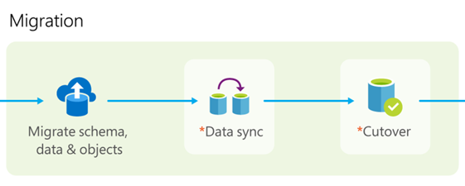
Data Migration Process
Notes:
*Pre-migration*:
- **Discover**: Inventory your source database assets and perform an application stack discovery.
- **Assess**: Assess source workloads and fix recommendations.
- **Convert**: Convert the source schema to work in the target environment. This is only relevant for heterogeneous migrations.
*Migration*:
- **Migrate schema, data, and objects**: Migrate the source schema and then migrate the source data to the target.
- **Sync data**: Sync your target schema and data with the source. This is only relevant for minimal-downtime migrations.
- **Cutover**: Cut over from the source to the target environment. This is only relevant for minimal-downtime migrations.
*Post-migration*:
- **Remediate applications**: Iteratively make any necessary changes to your applications.
- **Perform Tests**: Iteratively run functional and performance tests.
- **Optimize**: Based on the tests you performed, address any performance issues and then retest to confirm the performance improvements.

Slide 37
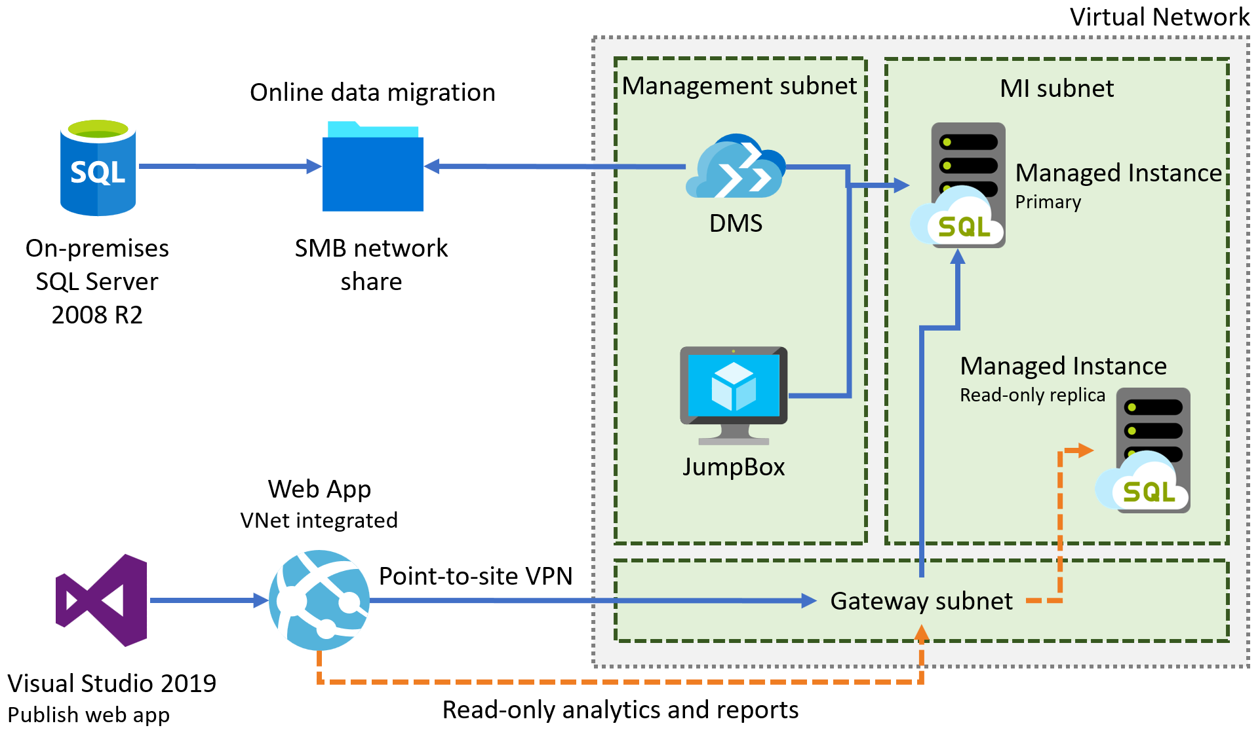
PoC – Gaming services
Notes:
Diagram of the preferred solution for the gaming services. The gaming services are hosted in a VNet, with subnets for MI, Game, Management, Auth, and a Gateway subnet. SQL MI instances are hosted in the MI subnet. Gaming IaaS VMs are hosted in the Game subnet. Authorization VMs are in the Auth subnet, and a JumpBox is in the Management subnet. On-premises resources can access the VNet through ExpressRoute or a VPN gateway.

Slide 38
PoC – Gaming services
Notes:
Diagram of the preferred solution for the gaming services. The gaming services are hosted in a VNet, with subnets for MI, Game, Management, Auth, and a Gateway subnet. SQL MI instances are hosted in the MI subnet. Gaming IaaS VMs are hosted in the Game subnet. Authorization VMs are in the Auth subnet, and a JumpBox is in the Management subnet. On-premises resources can access the VNet through ExpressRoute or a VPN gateway.

Slide 39


Preferred migration solution
Azure Migrate
Data Migration Assistant
Azure Database Migration Service
Azure Site Recovery
Partner or Azure Migrate Program engagement
Azure Hybrid Benefit
Prepay for Reserved Capacity
Notes:
Cost minimization
Azure Hybrid Benefit
Reserved capacity payments
DMS
3 month timeframe
DMS
ASR
AMP
Partner engagement
Dedicated resources

Slide 40
Azure Hybrid Benefit for SQL Server
License trade-in values
Take an inventory of on-premises licenses to determine potential for conversion
Convert on-premises cores to vCores to maximize value of investments
1 Standard license core = 1 General Purpose or Hyperscale core
1 Enterprise license core = 1 Business Critical core
1 Enterprise license core = 4 General Purpose or Hyperscale cores (virtualization benefit)
SQL Server cores with SA license
vCores on Azure SQL Database
SQL Server Standard Edition
General purpose or Hyperscale vCore
Business critical vCore
SQL Server Enterprise Edition
4x General purpose or Hyperscale vCores
Notes:
SQL Server Enterprise Edition customers can use an unlimited virtualization benefit for their on-premises workloads. However, moving to the cloud to take advantage of its management, flexibility and cost benefits can be cost prohibitive for some heavily virtualized customers. The Azure Hybrid Benefit for SQL Server provides SQL Enterprise Edition customers with Software Assurance the ability to get 4 cores in the cloud for every 1 core they own on-premises for workloads moving to the General Purpose or Hyperscale SKU – the SKU that best meets the requirements for highly virtualized workloads. This makes moving virtualized applications to SQL Database highly cost effective as customers will not have to purchase incremental vCores to move their virtualized application to the cloud.

Slide 41
Post-Migration

Slide 42
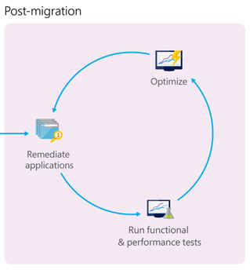
Data Migration Process
Notes:
*Pre-migration*:
- **Discover**: Inventory your source database assets and perform an application stack discovery.
- **Assess**: Assess source workloads and fix recommendations.
- **Convert**: Convert the source schema to work in the target environment. This is only relevant for heterogeneous migrations.
*Migration*:
- **Migrate schema, data, and objects**: Migrate the source schema and then migrate the source data to the target.
- **Sync data**: Sync your target schema and data with the source. This is only relevant for minimal-downtime migrations.
- **Cutover**: Cut over from the source to the target environment. This is only relevant for minimal-downtime migrations.
*Post-migration*:
- **Remediate applications**: Iteratively make any necessary changes to your applications.
- **Perform Tests**: Iteratively run functional and performance tests.
- **Optimize**: Based on the tests you performed, address any performance issues and then retest to confirm the performance improvements.

Slide 43
Post-migration PoC
Explore and test Azure security, performance, and scale platform benefits
Validate and optimize a migration – https://aka.ms/OptimizeMigrations
Scale a migration – https://aka.ms/ScaleMigrations
Engage Azure Migrate Program or Partner
Notes:
*Pre-migration*:
- **Discover**: Inventory your source database assets and perform an application stack discovery.
- **Assess**: Assess source workloads and fix recommendations.
- **Convert**: Convert the source schema to work in the target environment. This is only relevant for heterogeneous migrations.
*Migration*:
- **Migrate schema, data, and objects**: Migrate the source schema and then migrate the source data to the target.
- **Sync data**: Sync your target schema and data with the source. This is only relevant for minimal-downtime migrations.
- **Cutover**: Cut over from the source to the target environment. This is only relevant for minimal-downtime migrations.
*Post-migration*:
- **Remediate applications**: Iteratively make any necessary changes to your applications.
- **Perform Tests**: Iteratively run functional and performance tests.
- **Optimize**: Based on the tests you performed, address any performance issues and then retest to confirm the performance improvements.

Slide 44
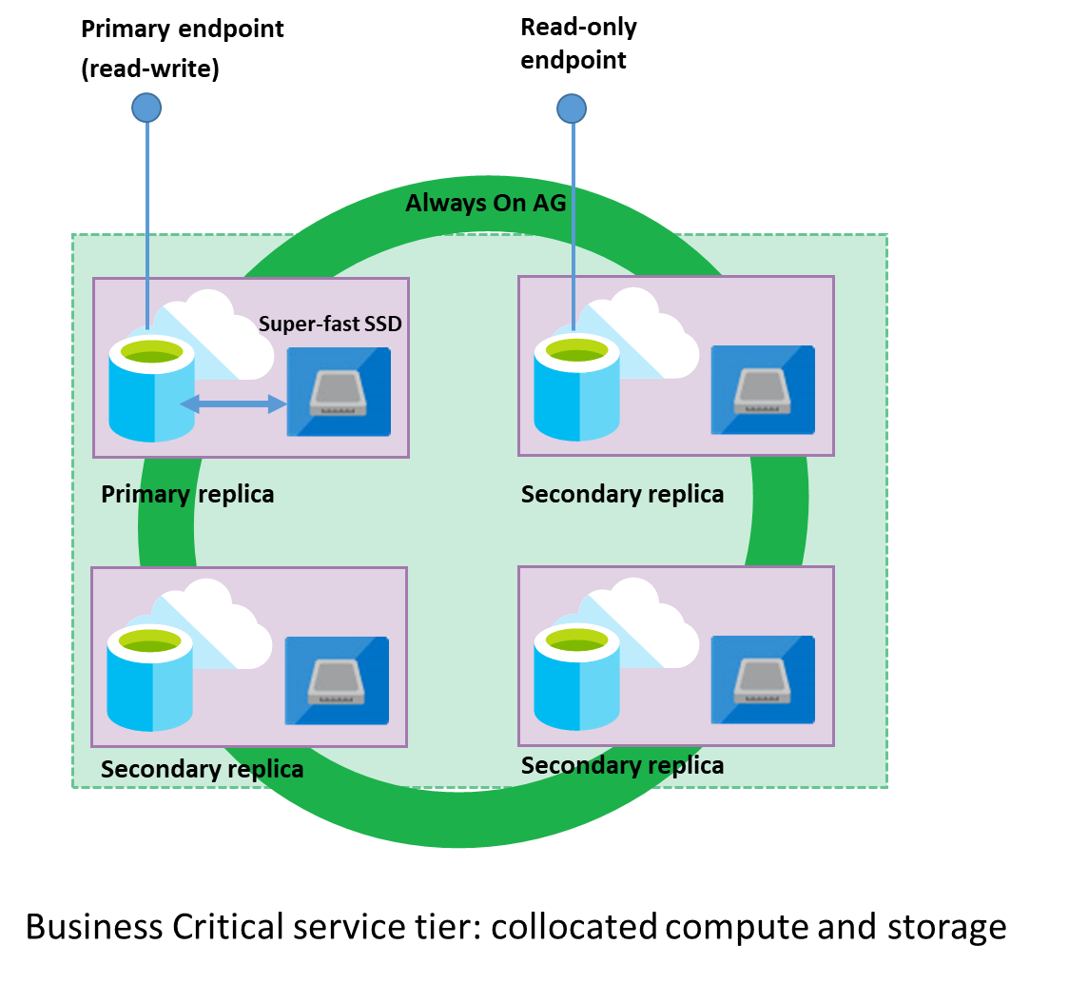
Read-only reporting
Read Scale-out
Read-only replica
Free with SQL MI BC
Hyperscale provides this too.
Notes:
https://docs.microsoft.com/en-us/azure/sql-database/sql-database-read-scale-out
As part of the High Availability architecture, each database in the Premium, Business Critical or Hyperscale service tier is automatically provisioned with a primary replica and several secondary replicas. The secondary replicas are provisioned with the same compute size as the primary replica. The Read Scale-Out feature allows you to load-balance SQL Database read-only workloads using the capacity of one of the read-only replicas instead of sharing the read-write replica. This way the read-only workload will be isolated from the main read-write workload and will not affect its performance. The feature is intended for the applications that include logically separated read-only workloads, such as analytics. They could gain performance benefits using this additional capacity at no extra cost.
3 secondary replicas, 1 is read scale out with MI BC

Slide 45
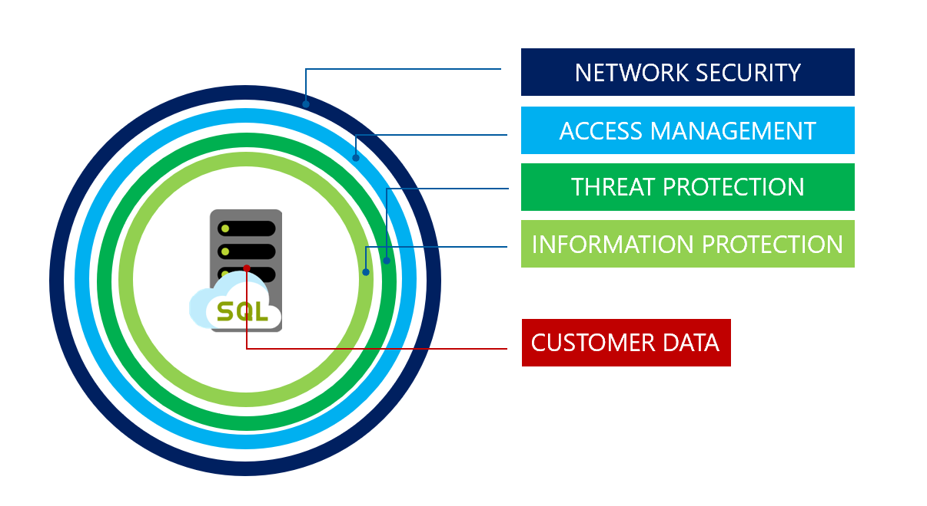
Advanced Data Security
Notes:
SQL MI includes numerous security tools that could be leveraged by Tailspin Toys, including:
SQL Database Advance Data Security
SQL Data Discovery and Classification
SQL Vulnerability Assessment service
Advanced Threat Detection
Transparent Data Encryption
Dynamic Data Masking
Row-level security

Slide 46
After the migration

Slide 47
Next steps for Azure SQL + Migrations
http://aka.ms/annalytics
twitter: @AnalyticAnna
microsoft: antho@
Use our free training at https://aka.ms/sqlworkshops
The content from today is Modules 4 and 5 of SQL Ground to Cloud!
Learn from videos and demos at https://aka.ms/sqldbonyoutube
See and reuse useful Azure SQL slides at https://aka.ms/azuresqlslides
Engage the Azure Migrate Program at https://azure.com/AMP/

Slide 48
What you will learn in this workshop
Capability exists for Azure SQL Database
(Managed instance, single databases,
and elastic pools)
Capability exists for Azure SQL VMs
Discover and assess what and where to migrate to Azure
Azure Migrate
Migrate to Azure SQL Managed Instance with little to no downtime
Azure Database Migration Services
Improve database security with Advanced Data Security
SQL Data Discovery and Classification
Obtain read-scale out for read only queries
Online secondary read replica
Vulnerability Assessment
Data Migration Assistant
TODAY

Slide 49
Lab:
Notes:
Switch PPT!

Slide 50
Lab set-up
Sign-Up Link (For All): http://bit.ly/36lege5
Activation Code: ACTIVATE4668

Slide 51
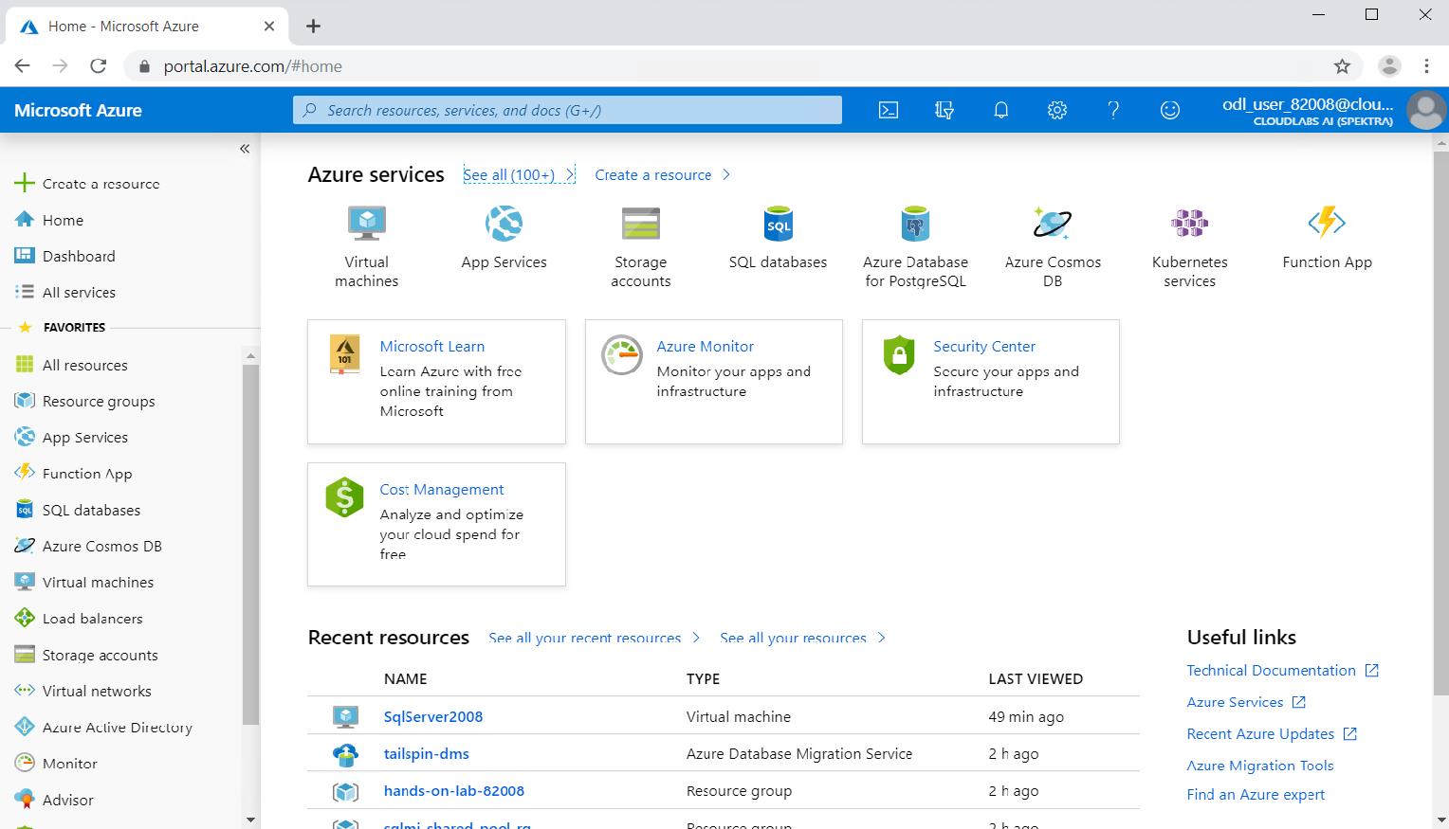

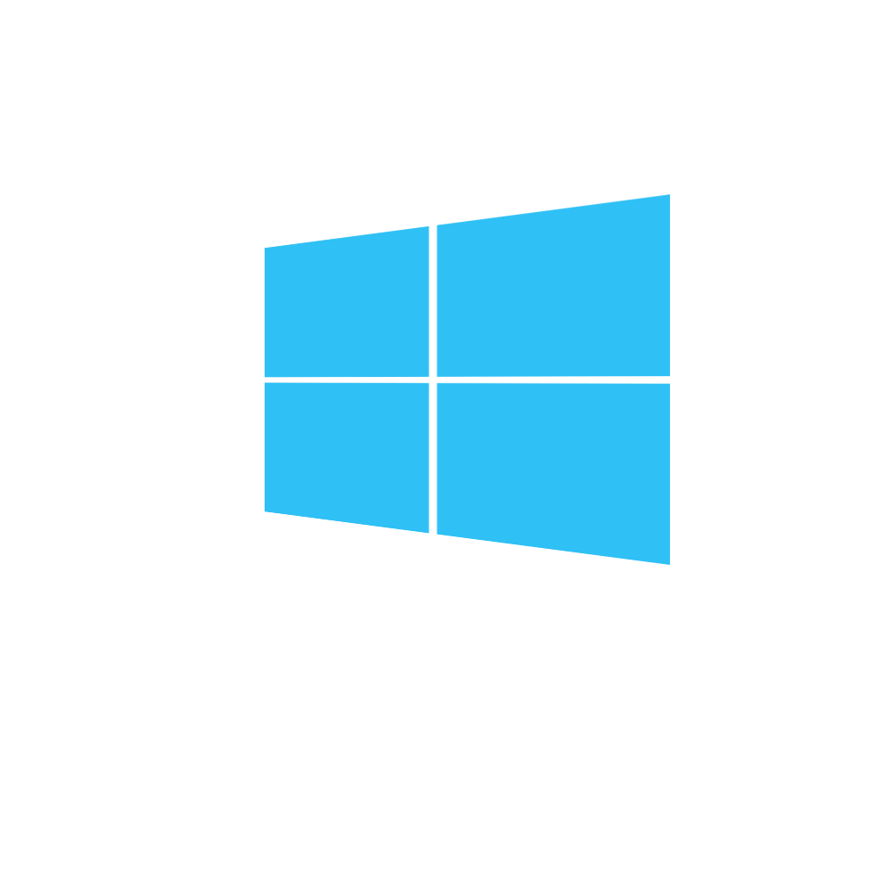

Using Lab Resources
Database Migration Project
Application/ClientId
Application Secret Key
SQL 2008 VM
sqlVmPublicIp
sqlvmUsername
sqlvmPassword
sqlVmPrivateIp
SQL Login
SQLServer2008Username
SQLServer2008Password
Azure portal
SQL
rdp
JumpBox VM
rdp
miFQDN
sqlMiUsername
sqlMiPassword
Your laptop
jbvmDnsName
vmUsername
vmPassword

